Slide 1
ATAR Unit 3-Geography Depth Study 2
Syllabus points:
A program designed to address the impacts of land cover change on local and regional environments.
An evaluation of the program, giving consideration to environmental, economic and social benefits and costs.
Link to Global Climate Change

Slide 2
A specific example – Use text book Page 143 * Read page 143 – ‘Agroforestry’ * Take file notes * Use specific examples – EXAMPLES of where it is taking place, including the Oil Mallee Project. * Read page 148 – ‘Read the evaluation of programs – Agroforestry’. * Take file notes

Slide 3
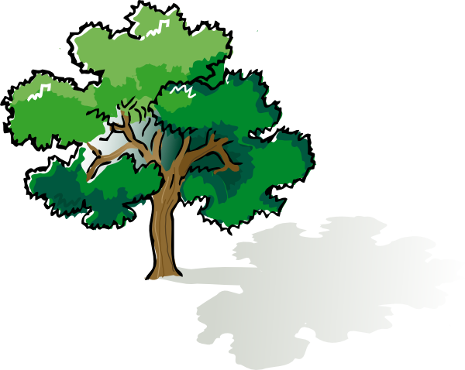
What is Agroforestry?
The intentional combining of agriculture and working trees to create sustainable farming.
Growing timber with traditional farm products to benefit farmers, the timber industry and the environment.
Farm forestry is the integration or combination of both forestry activities with other agricultural activities, such as grazing of livestock – cattle and sheep and cropping (growing of crops), such as wheat, barley and oats on a farm.
Farm forestry plantations are usually or in most cases grown (established) on marginally productive or unproductive land.

Slide 4
Agroforestry – Links to Adaptation to and Mitigation of Global Climate Change
Mitigation of climate change mainly takes the form of carbon sequestration, e.g. biomass, either above or below the ground.
Carbon sequestration – is the process involved in carbon capture and the long term storage of atmospheric carbon dioxide (CO22)
Adaptation to climate change is very much a function of soil organic matter content and diversified, multispecies (varieties) cropping technologies.
Summary – Agroforestry can help with climate change mitigation and adaptation.
It increases storage for carbon and may also enhance (improve) agricultural productivity.

Slide 5
Key Information – Linking to Global Climate Change (Natural & Anthropogenic)
Over the last century, Australia’s mean annual temperature has said to have increase by 0.9°C.
South-western Australia has experienced long-term reductions in winter rainfall.
Increased GHG concentrations is thought to be responsible for much of this change.
Current rates of GHG emissions continue (same rate or higher) – Possible impacts??
Western Australia’s mean annual temperatures could be 2-5°C warmer by 2070. Rainfall could continue to decline by up to 20% (over the state)
➢ Action (What is happening?)– Australia as a country is working towards various measures to reduce GHG emissions and sequester (remove) carbon – goal of limiting global warming to less than 2°C.

Slide 6
Agroforestry – Links to “What is carbon farming?”
Fast Fact: Agriculture is responsible for approximately 14% of Australia’s GHG emissions
Carbon farming is managing water, vegetation, animals and soils to increase carbon storage or reduce greenhouse gas (GHG) emissions.
GHG’s are emitted by the following activities:
 soil disturbance - tillage
 production and use of fertilisers, e.g. nitrogen based
 transporting produce, such as ‘intensive agriculture’ – perishable goods (fruit, milk)
 farm machinery use – cropping/seeding, harvesting
 land clearing
 livestock production – such as cattle
➢ Improved farming practices can sequester (store) carbon in the soil and also plant biomass.

Slide 7
Objectives of Agroforestry – What the farmer wants to achieve by revegetating an area?
Salinity Management
Shade and shelter for livestock
Carbon sequestration – e.g oil mallees
Fodder for livestock – e.g. forage shrubs can provide valuable green feed for livestock during summer and autumn and during drought periods
Wind and/or water erosion control
Wildlife habitats and corridors
Harvesting firewood and timber – e.g. timber crops are an option for production in higher rainfall areas of the Wheatbelt.

Slide 8
Agroforestry Practices
EXAMPLES:
Forest farming – intensive management, intentional manipulation and integration of woodlands. Managed forest canopy to produce non-timber products. Benefits: Increase cash flow, diversify operations and income, such as handicrafts and food products.
Alley farming or cropping – growing a perennial or annual crop, such as wheat, barley, oats, in the alley ways between rows of a long term tree crop. Agricultural crop produces an income for farmer. Benefits: diversify farming operation, protect crops, store carbon, improve water quality, helps with salinity issues, reduce erosion, provide wildlife habitats.
Windbreaks – planting of multiple or single rows of trees or shrubs. Modify and redirect wind. Helps to deal with wind erosion issues etc… Benefits: shelter livestock, increase crop yields, provide habitats for wildlife, sequester carbon
Forest buffers around water bodies, such as rivers – Benefits: protect stream banks, protect aquatic habitats, clean water, flood protection

Slide 9
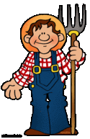
BENEFITS & COSTS of Agroforestry SOCIAL
Social Benefits:
List examples of the social benefits
Increased land values - Trees increase land and/or property values – Well-planted properties may increase value by up to 15%.
Community involvement such as sporting organisations assisting with tree planting efforts.
Agroforestry and trees could reduce stress levels of farmers.
---------------------------------------------------------------------------
ADD OTHERS?
Social Costs:
List examples of the social costs
Costs of NRM (Natural Resource Management) consultation – discussions with various stakeholders about agroforestry – differences in opinion. Why?
Farms maybe owned in partnership so agreement between people involved in the partnership may be difficult to achieve, as one partner may not agree with benefits of agroforestry and vice versa.
Not re-vegetating or using agroforestry could result in a decline or decrease in property values or not being able to sell a farming property or reduction in offers placed on the farm, which could lead to stress on families and farmers.

Slide 10
BENEFITS & COSTS of Agroforestry ECONOMIC
Economic Benefits:
List examples of the economic benefits
Agroforestry could assist with a sound source of farm income, particularly in areas where rainfall is able to support the activity.
Agroforestry can provide protection, such as shade and shelter for livestock.
Some species (mallee), may be suitable for the production of biofuels. Creation of new alternatives and industries.
Increased land values
ADD OTHERS?
Economic Costs:
List examples of the economic costs
Trees become profitable as they produce positive net present values over time. Break even point occurs after a number of years. (Delayed return on investment)
Sometimes markets for tree products are both less efficient and less developed than for agricultural commodities.
Costs associated with the tree planting, including seedlings etc.
Establishment and ongoing costs – original plantings
Depending on the area used, it could mean labour force may decline on the farm as possibly less agricultural operations.

Slide 11
BENEFITS & COSTS of Agroforestry ENVIRONMENTAL
Environmental Benefits:
List examples of the environmental benefits
Agroforestry can assist in lowering the water table, preventing or assisting with salinity. Help to address salinity.
Agroforestry can use surplus fertilisers from farming operations, thus prevents some issues associated with eutrophication.
Agroforestry can relieve pressure on native forests, as it could be used to grow commercial sawlogs.
Helps to restore degraded landscapes. Protects soils.
Helps to provide biodiversity habitats and corridors.
Can assist with preventing wind and water erosion.
Provides shade and a cooler environment to sensitive crops or animals, agroforestry can assist in maintaining or increasing yields.
Agroforestry contributes to climate change adaptation and mitigation. Can help to reduce impact of climate change on agriculture and inversely, decrease agriculture’s contribution to the phenomenon (climate change).
Carbon sequestration
Environmental Costs:
List examples of the environmental costs
Change to existing land use in some circumstances – generally uses un-productive land.
Possible disruption to existing systems
ADD OTHERS?

